Slide 1
Progressive Web Apps

Slide 2
Websites Or Native Apps

Slide 4
80%
Of Time Spent In
USERS’ Top 3 Apps

Slide 5
What was missing?
Reliable Performance
Push Notification
Home screen icon metadata

Slide 6
40% of users bounce from sites that take longer than 3 seconds to load

Slide 7
What is Progressive Web Apps?
The term "Progressive Web App" isn't a formal or official name. It's just a shorthand used initially by Google for the concept of creating a flexible, adaptable app using only web technologies.
For example, web apps are more discoverable than native apps; it's a lot easier and faster to visit a website than to install an application, and you can also share web apps by sending a link.
On the other hand, native apps are better integrated with the operating system and therefore offer a more seamless experience for the users. You can install a native app so that it works offline, and users love tapping their icons to easily access their favorite apps, rather than navigating to it using a browser.

Slide 8
What makes an app a PWA?
Discoverable, so the contents can be found through search engines.
Installable, so it can be available on the device's home screen or app launcher.
Linkable, so you can share it by sending a URL.
Network independent, so it works offline or with a poor network connection.
Progressive, so it's still usable on a basic level on older browsers, but fully-functional on the latest ones.
Re-engageable, so it's able to send notifications whenever there's new content available.
Responsive, so it's usable on any device with a screen and a browser—mobile phones, tablets, laptops, TVs, refrigerators, etc.
Safe, so the connections between the user, the app, and your server are secured against any third parties trying to get access to sensitive data.

Slide 9
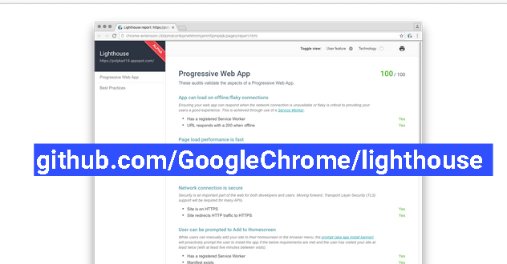

Slide 10


Slide 11
Architecture Of an App
There are two main, different approaches to rendering a website — on the server or on the client. They both have their advantages and disadvantages, and you can mix the two approaches to some degree.
Server-Side Rendering
Client-Side Rendering

Slide 12

What are the technical components of PWA

Slide 13
Service Worker
A Service Worker is just a piece of JavaScript that works as a proxy between the browser and the network. A SW supports push notifications, background sync, caching, etc.

Slide 14
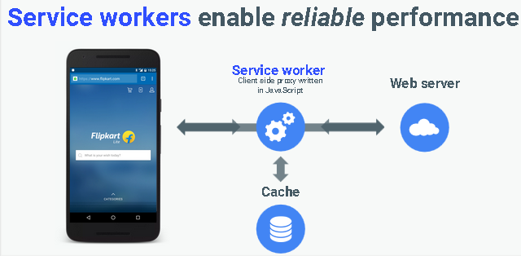

Slide 15
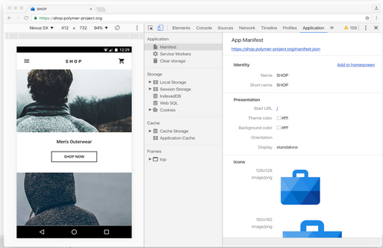

Slide 16
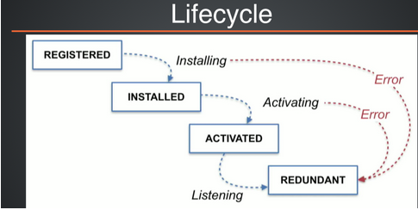
The Service Worker life cycle

Slide 17
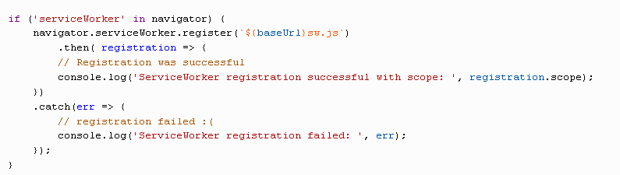
Register Service Worker

Slide 18
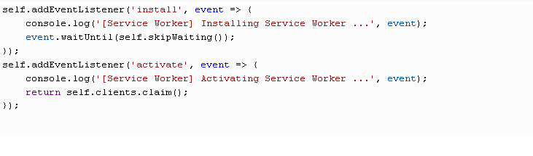
Install and Activate Service Worker

Slide 19
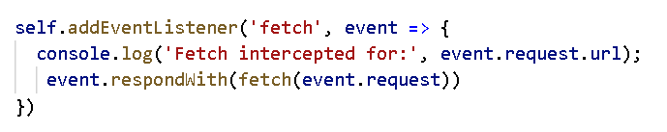
Fetch

Slide 20
Fetch API
the Fetch API, a simple interface for fetching resources, and an improvement over the XMLHttpRequest API.

Slide 21
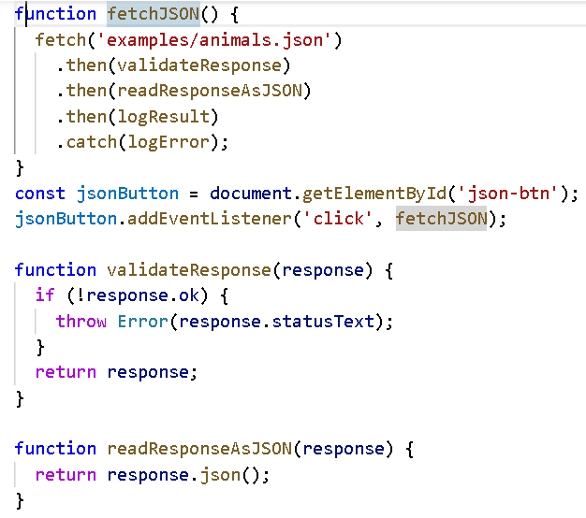

Slide 22
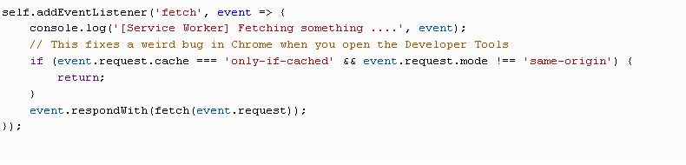
Add to Home Screen Feature

Slide 23
Activating the install prompt
Chrome 67 prompted users automatically, but starting in Chrome 68, the install prompt should be activated programmatically in response to a user gesture.
The beforeInstallPromptEvent is fired at the window.onbeforeinstallprompt handler before a user is prompt to “install” a web site to a home screen on mobile

Slide 24
Manifest File
The web app manifest is a JSON file that tells the browser about your Progressive Web App and how it should behave when installed on the user's desktop or mobile device. A typical manifest file includes the app name, the icons the app should use, and the URL that should be opened when the app is launched.

Slide 25
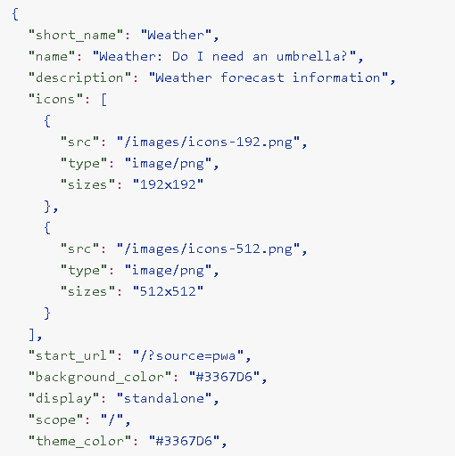

Slide 26
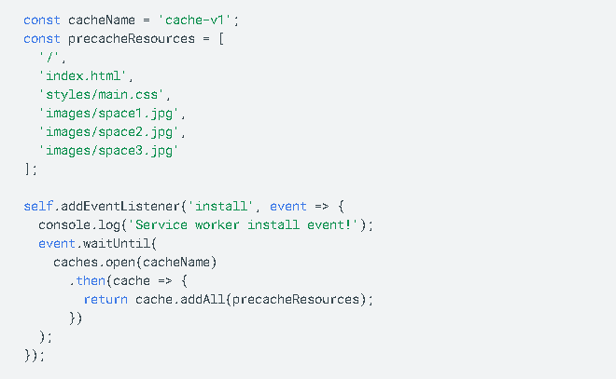
Working Offline

Slide 27
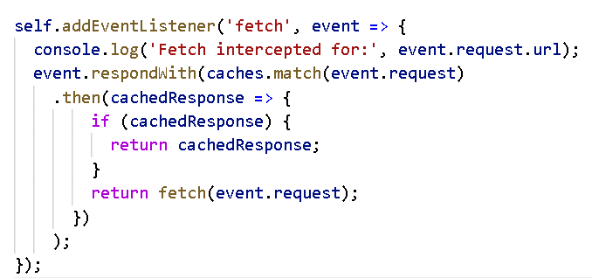
Working Offline cont.

Slide 28
IndexedDB
IndexedDB is a low-level API for client-side storage of significant amounts of structured data. This API uses indexes to enable high-performance search of this data.
While Web Storage is useful for storing smaller amounts of data, it is less useful for storing larger amounts of structured data.

Slide 29
Offline Wikipedia app, a demo by Jake Archibald
Flipkart Lite, an e-commerce company
Voice Memos, a sample web app that records voice memos
AliExpress, one of the world's largest e-commerce sites
BaBe, an Indonesian news aggregator service
United eXtra, a leading retailer in Saudi Arabia
The Washington Post, America’s most widely circulated newspaper published in Washington, D.C.

